Slide 1
① DB 접속 정보
- Host, Port, DB명, 계정, 비밀번호
(비밀번호는 보안 채널로 별도 전달 부탁드립니다)
SQLCA_NSS_ID = 'nssdb'
SQLCA_NSS_PW = 'nss2109'
SQLCA_NSS_IP = '121.141.174.121'
SQLCA_NSS_DB = 'KIOSK'
SQLCA_NSS = Create Transaction
SQLCA_NSS.DBMS = "OLE DB"
SQLCA_NSS.LogId = SQLCA_NSS_ID
SQLCA_NSS.LogPass = SQLCA_NSS_PW
SQLCA_NSS.AutoCommit = False
ls_DBParm = "PROVIDER='SQLOLEDB',DATASOURCE='" + SQLCA_NSS_IP + "',PBCatalogOwner='dbo',PROVIDERSTRING='database=" + SQLCA_NSS_DB + "'"
SQLCA_NSS.DBParm = ls_DBParm
CONNECT USING SQLCA_NSS ;
② 기존 엑셀 다운로드 프로그램에서 사용하는 SQL 쿼리문
- 소스 전체가 아닌 SELECT 쿼리 부분만으로도 충분합니다
SELECT B.EMR_COMPANY,
B.HOSP_NM,
A.KIOSK_ID ,
A.COUNT_DATE,
SUM(A.COUNT_01) AS '재진접수',
SUM(A.COUNT_02) AS '도착확인',
SUM(A.COUNT_03) AS '진료예약',
SUM(A.COUNT_04) AS '진료수납',
SUM(A.COUNT_05) AS '세부내역서',
SUM(A.COUNT_06) AS '번호표발행',
SUM(A.COUNT_07) AS '주차등록',
SUM(A.TAMT) AS '결제금액'
FROM KIOSK_HOSP_COUNT A, KIOSK_HOSP_INFO B
WHERE A.HOSP_CD = B.HOSP_CD
AND A.COUNT_DATE >= '2026-02-01'
AND A.COUNT_DATE <= '2026-02-24'
GROUP BY B.EMR_COMPANY,
B.HOSP_NM,
A.KIOSK_ID,
A.COUNT_DATE
ORDER BY B.EMR_COMPANY,
B.HOSP_NM,
A.KIOSK_ID,
A.COUNT_DATE

Slide 2
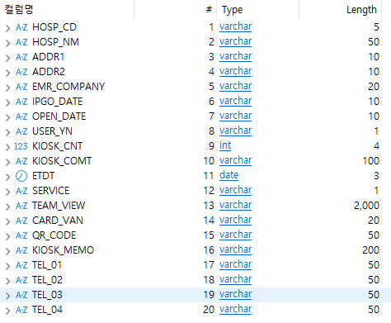
③ 부여된 DB 계정으로 접근 가능한 테이블 목록
- SHOW GRANTS 또는 테이블 목록 스크린샷으로 주셔도 됩니다
KIOSK_HOSP_INFO
KIOSK_HOSP_COUNT

